Slide 1
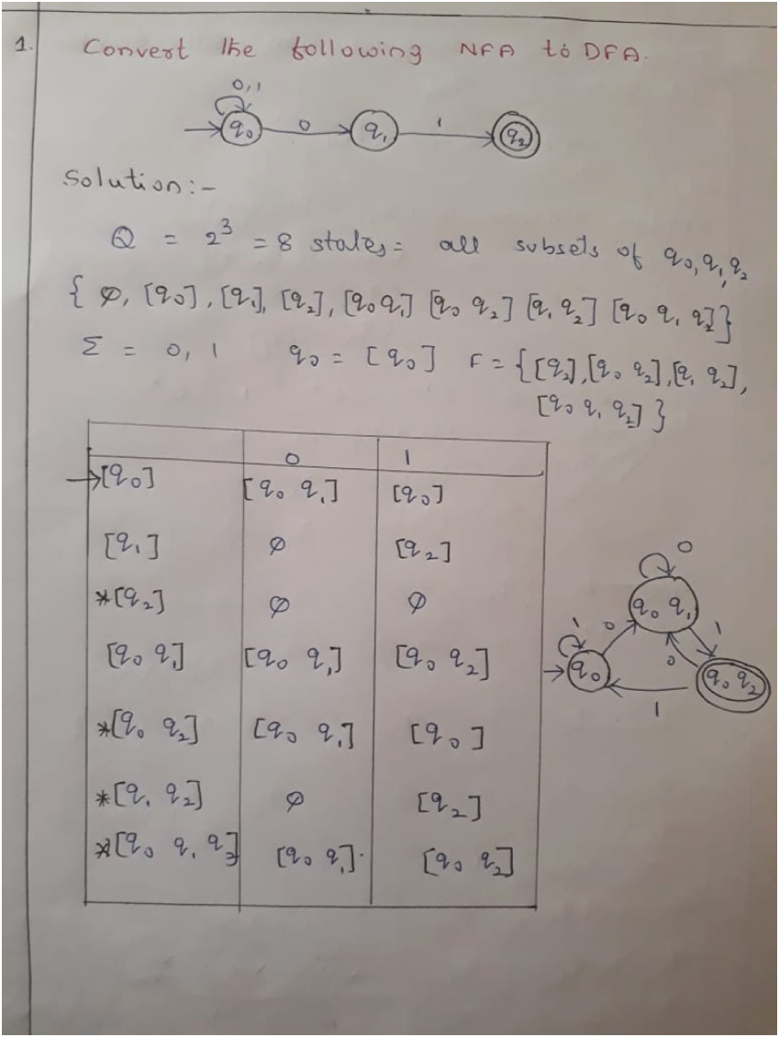

Slide 2
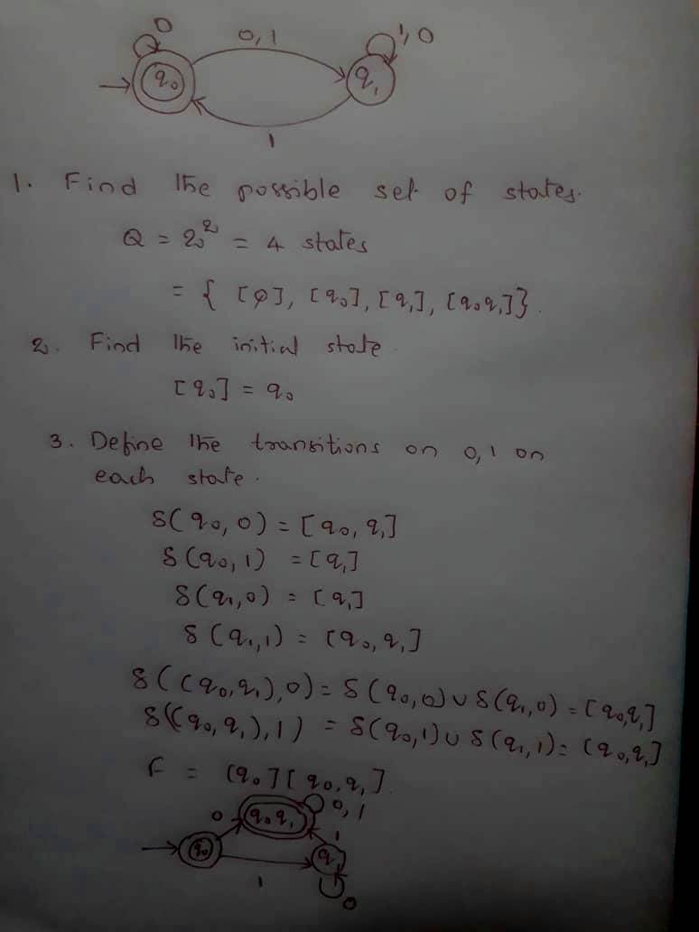
Conversion from NFA to DFA

Slide 3
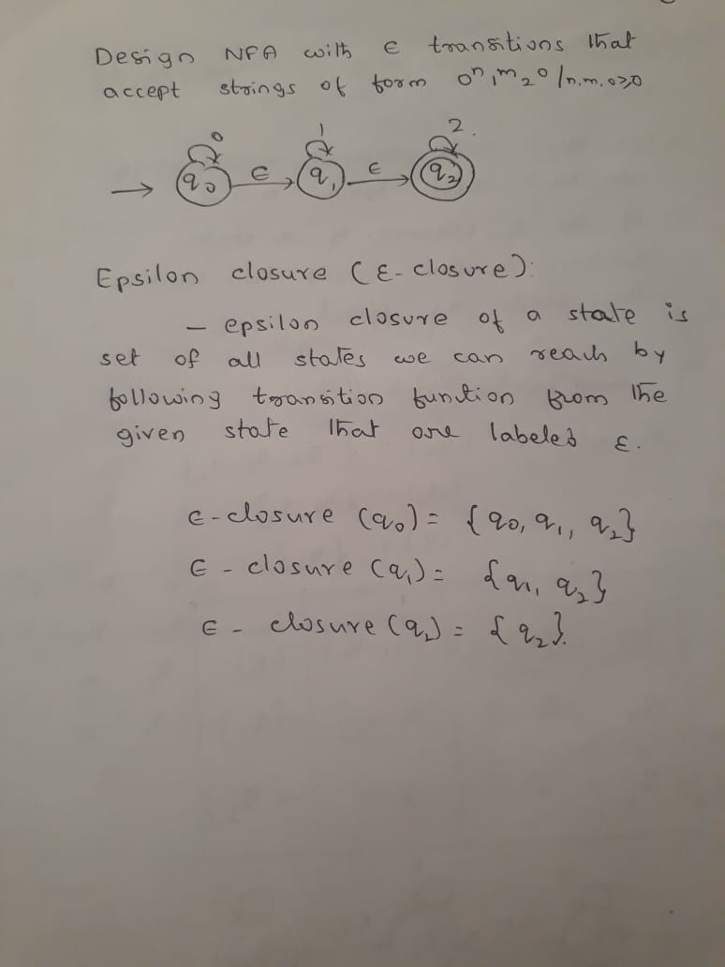
Conversion from NFA-epsilon to NFA

Slide 4
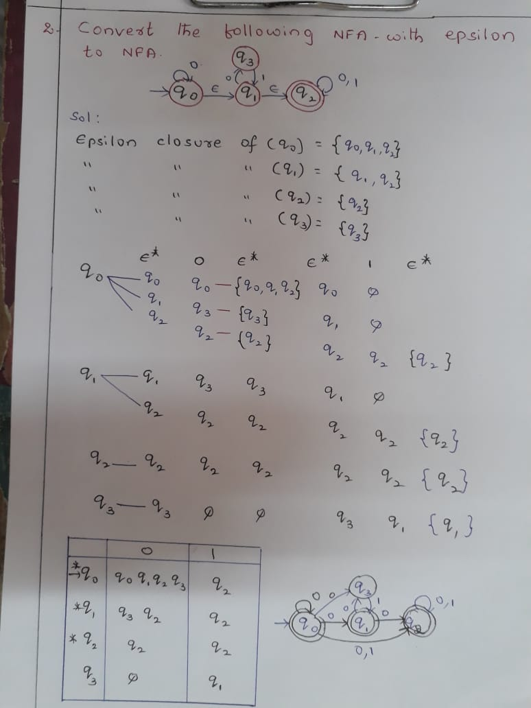
Conversion from NFA-epsilon to NFA
1

